Slide 1

Business Process Engineering Week # 11
Spring-2024

Slide 2
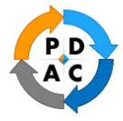
Plan–Do–Check–Act (PDCA)
Framework for problem-solving, continuous improvement and change
Widely recognized as the basis of continually improving the quality of processes, products and services
Provides a simple and structured approach for solving quality-related problems
Multiple iterations of the PDCA cycle may be necessary to solve the problem permanently and reach the ultimate goal
Used to verify the feasibility of a problem whether it is an incremental or breakthrough improvement
Often used when:
Intending to make minor changes to a process
Solution to the problem is known

Slide 3
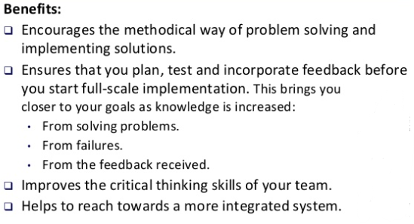
PDCA Benefits

Slide 4
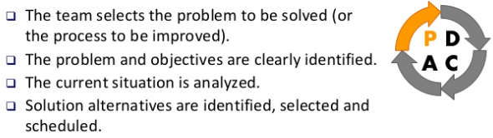
PLAN Step

Slide 5
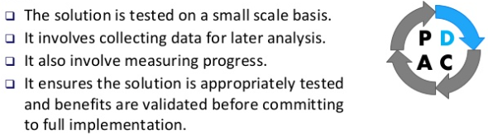
DO Step

Slide 6
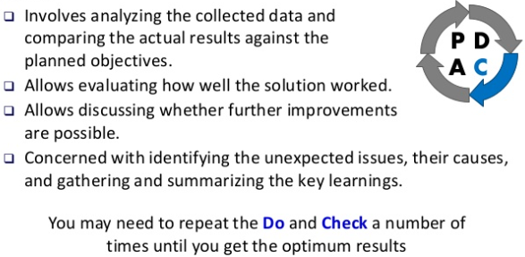
CHECK Step

Slide 7
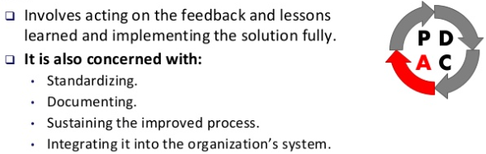
ACT Step

Slide 8
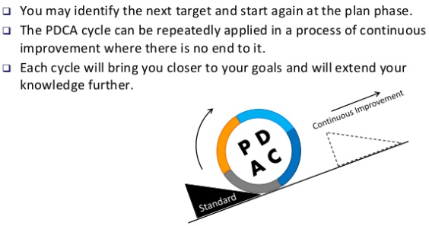
Continuous Improvement Tool

Slide 9
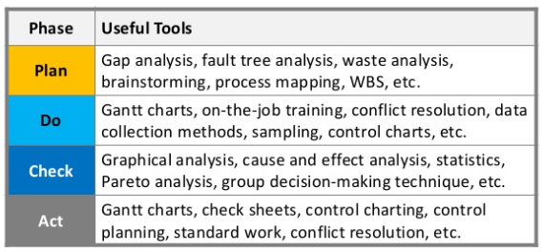
Tools used during PDCA Steps

Slide 10
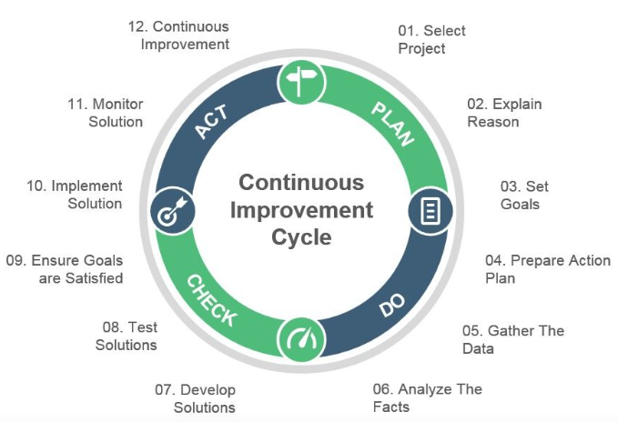

Slide 11
Toyota’s A3 Method
Toyota, with around 350,000 employees, is known for its continued commitment to improving operational performance with a Lean thinking tool called the A3 process
A3 process is a problem solving tool Toyota developed to foster learning, collaboration, and personal growth in employees.
The term “A3” is derived from the particular size of paper (11” X 17”) used to outline ideas, plans, and goals throughout the A3 process.
Toyota uses A3 reports for:
Problem Solving
Reporting Project Status
Proposing Policy Change

Slide 12
Why Use an A3 Process?
Allows groups of people to actively collaborate on the purpose, goals, and strategy of a project
Encourages in-depth problem solving throughout the process and adjusting as needed to ensure that the project most accurately meets its intended goal
Helps an organization to foster effective collaboration and bringing out the best problem solving in teams
Using the A3 process to foster collaboration can help organizations and teams invest their time, money, and momentum most effectively.

Slide 13
Steps of the A3 Process
There are nine (well, ten) steps in the A3 process.
0: Identify the problem
1: Capture the current state of the situation
2: Conduct a root cause analysis
3: Devise countermeasures to address root causes
4: Define your target state
5: Develop a plan for implementation
6: Develop a follow-up plan with predicted outcomes
7: Get everyone on board
8: Implement!
9: Evaluate Results

Slide 14
0: Identify the problem
The purpose of the A3 process is to solve problems or address needs
First, undocumented/unwritten step is that you need to identify a problem or need

Slide 15
1: Capture the current state of the situation
Observe the work processes and document your observations
Gather around a whiteboard and walk through each step in your process – use process charting tools or stick figures and arrows
If possible, quantify the problem size. Graph your data if possible, visualizations are really helpful

Slide 16
2: Conduct a root cause analysis
To figure out the root cause of the efficiencies. You can ask questions like:
Where do we suffer from communication breakdowns?
Where do we see long delays without activity?
What information are we needing to collaborate more effectively/smoothly?
The 5 whys is a helpful tool for conducting a thorough root cause analysis.

Slide 17
3: Devise countermeasures to address root causes
Countermeasures are your ideas for tackling the situation; the changes to be made to your processes that will move the organization closer to ideal by addressing root causes. Countermeasures should aim to:
Specify the intended outcome and the plan for achieving it.
Create clear, direct connections between people responsible for steps in the process.
Reduce or eliminate loops, workarounds, and delays.

Slide 18
4: Define your target state
Once you’ve selected your countermeasures, you are able to clearly define your target state. In the A3 process, you communicate our target state through a process map. Be sure to note where the changes in the process are occurring so they can be observed.

Slide 19
5: Develop a plan for implementation
Now that you’ve defined your target state, you can develop a plan for how to achieve it. Implementation plans should include:
A task list to get the countermeasures in place
Who is responsible for what
Due dates for any time-sensitive work items
Most teams choose to document their implementation plan in their A3.

Slide 20
6: Develop a follow-up plan with predicted outcomes
A follow-up plan allows Lean teams to check their work; it allows them to verify whether they actually understood the current condition well enough to improve it. A follow-up plan is a critical step in process improvement because it can help teams make sure the:
implementation plan was executed
target condition was realized
expected results were achieved

Slide 21
These first six steps are captured in the A3 report. Most teams use a template for their A3.

Slide 22
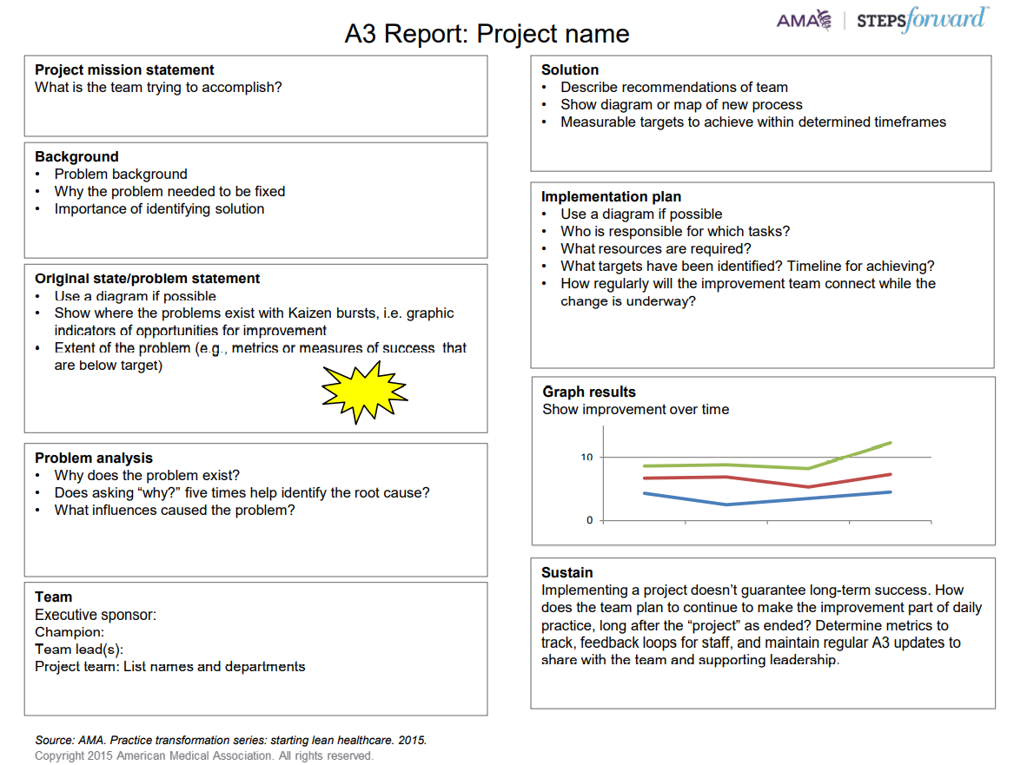

Slide 23
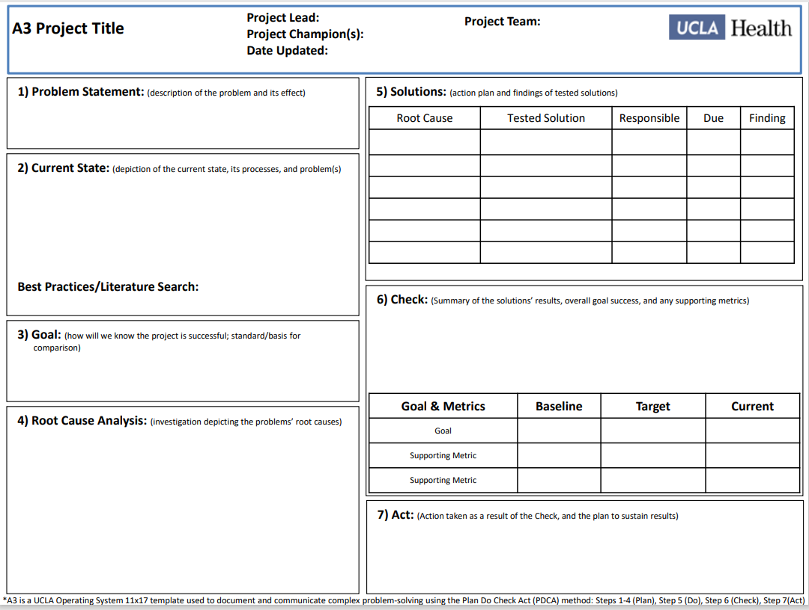

Slide 24
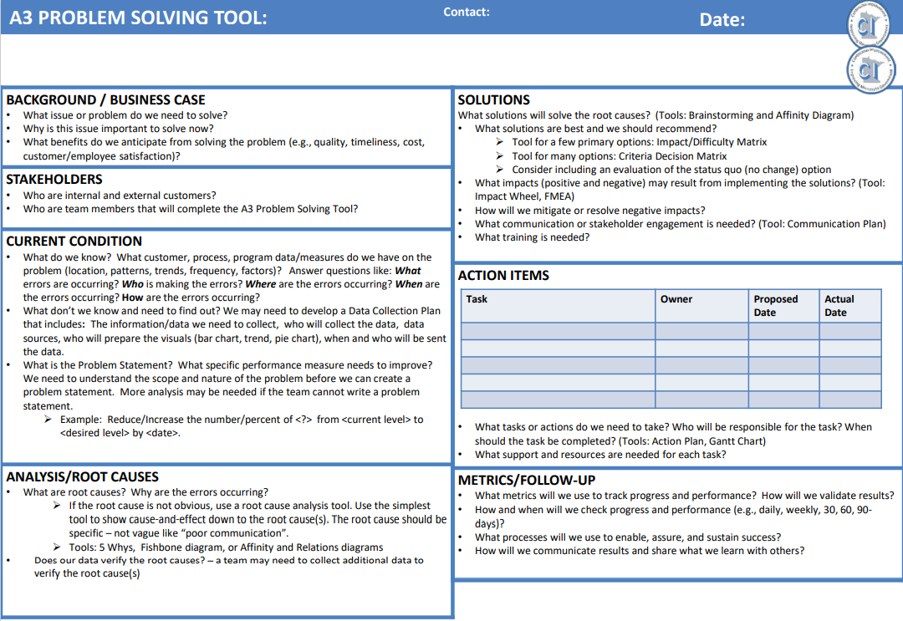

Slide 25
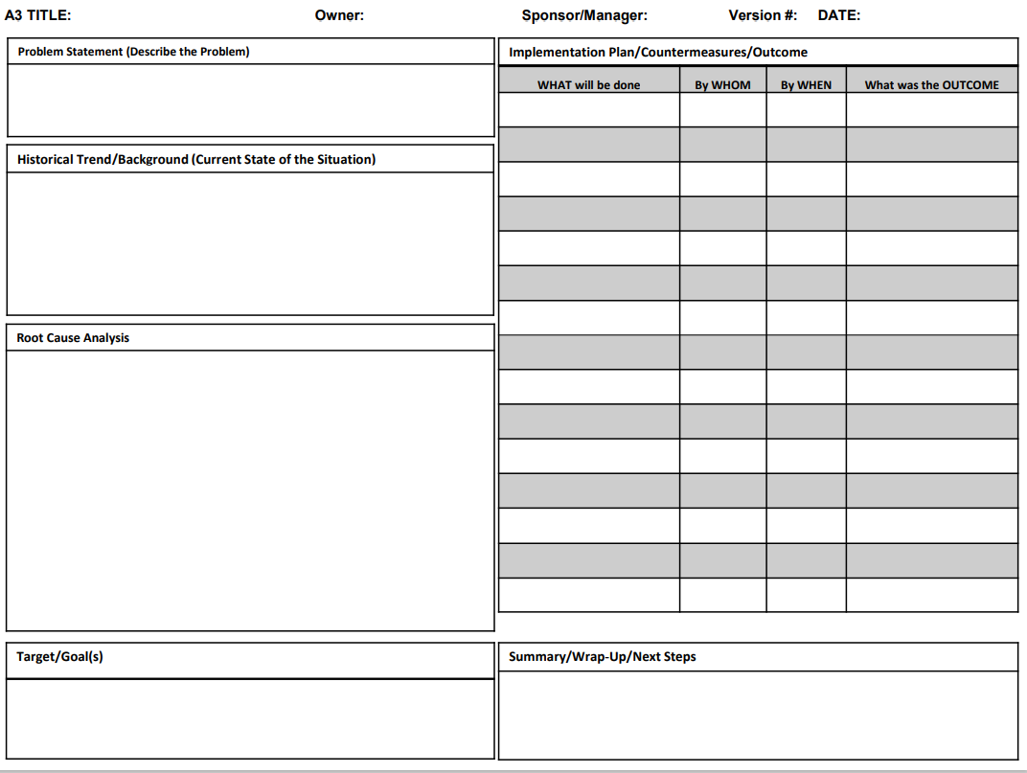

Slide 26
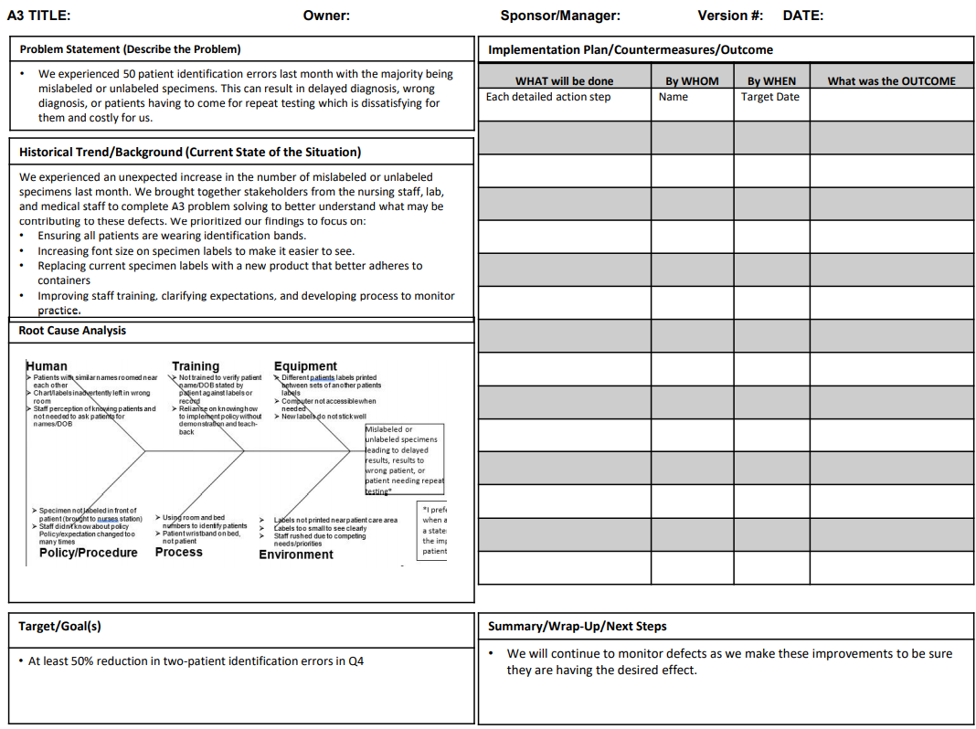

Slide 27
7: Get everyone on board
The goal for any systemic improvement is that it improves every part of the system. This is why it’s vital to include everyone who might be affected by the implementation or the target state in the conversation before changes are made.

Slide 28
7: Get everyone on board
Building consensus throughout the process is usually the most effective approach, which is why many teams choose to include this at each critical turning point in the A3 process. Depending on the scope of the work, it might also be important to inform executives and other stakeholders who might be impacted by the work.

Slide 29
8: Implement!
Now it’s time for implementation. Follow the implementation as discussed, observing opportunities for improvement along the way.

Slide 30
9: Evaluate Results
In far too many situations, the A3 process ends with implementation. It’s critical to measure the actual results and compare them to your predictions in order to learn.
If your actual results vary greatly from what was expected, do research to figure out why. Alter the process as necessary, and repeat implementation and follow-up until the goal is met.

